Slide 1
Coupa Supplier Portal (CSP) Training

Slide 2
13
How to Add Additional Team Members

Slide 3
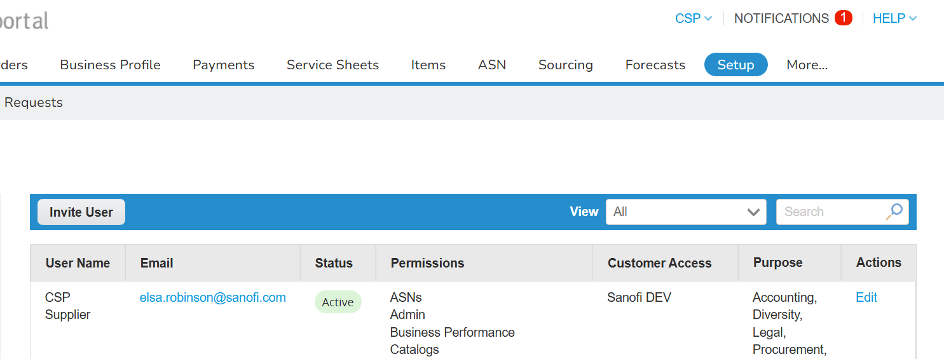
EXAMPLE
How to Add Additional Team Members (1/2)
1
Inviting Additional Team Members (1/2)
To invite an additional user:
Click the “Setup” tab
You will be taken to the Admin setup page, click on the “Invite User” button in the Users section*
2
*Note: Only CSP users with an Admin role will have permission to invite users.

Slide 4
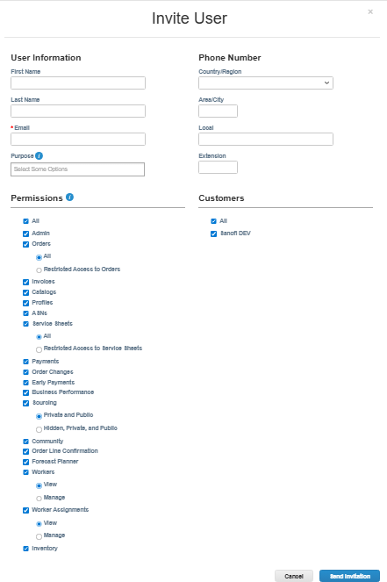
EXAMPLE
How to Add Additional Team Members (2/2)
3
Inviting Additional Team Members (2/2)
On the pop-up “Invite User” screen, input the required information
3a. Input the user’s name and email address
3b. Check/uncheck appropriately the fields in the “Permissions” and “Customers” sections to control the new user’s permissions and access
3c. Once complete, click “Send Invitation”, which will issue an email invitation to the new user. The new user will need to go through the same registration and log-in process, as previously described, in order to access the CSP
3a
3b
3c

Slide 5
14
How to Merge Accounts

Slide 6
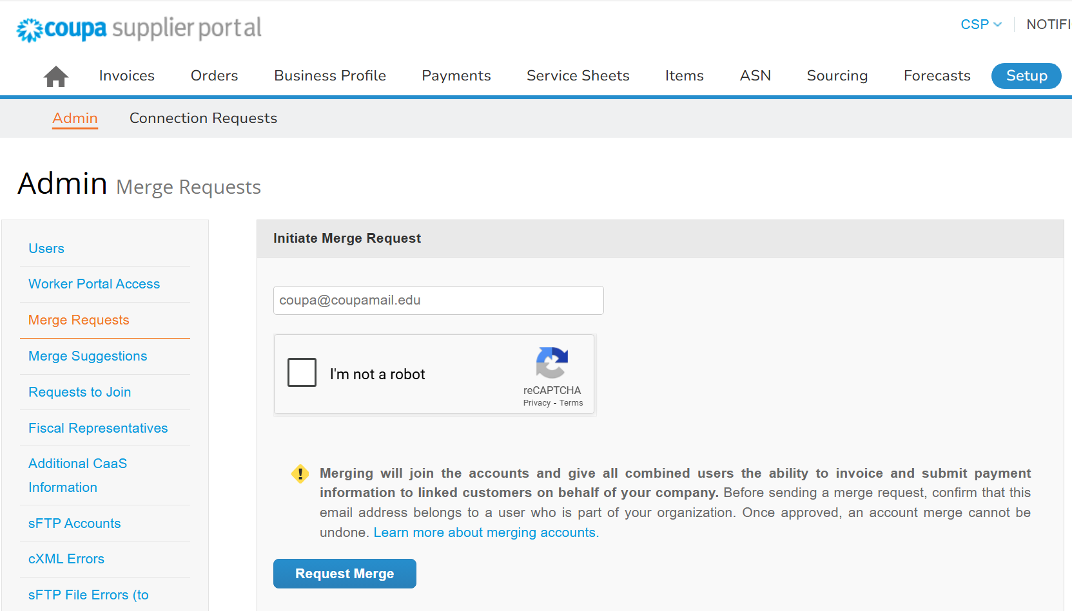
EXAMPLE
How to Merge Accounts (1/4)
1
How to Merge Accounts (1/4)
To merge accounts:
Click the “Setup” tab*
You will be taken to the Admin setup page, click on the “Merge Requests” link in the Users section*
Enter the email address of the account you wish to merge with and tick the “I’m not a robot” check box
Click on the “Request Merge” button
2
3
4
*Note: Only CSP users with an Admin role will have permission to merge CSP accounts.

Slide 7
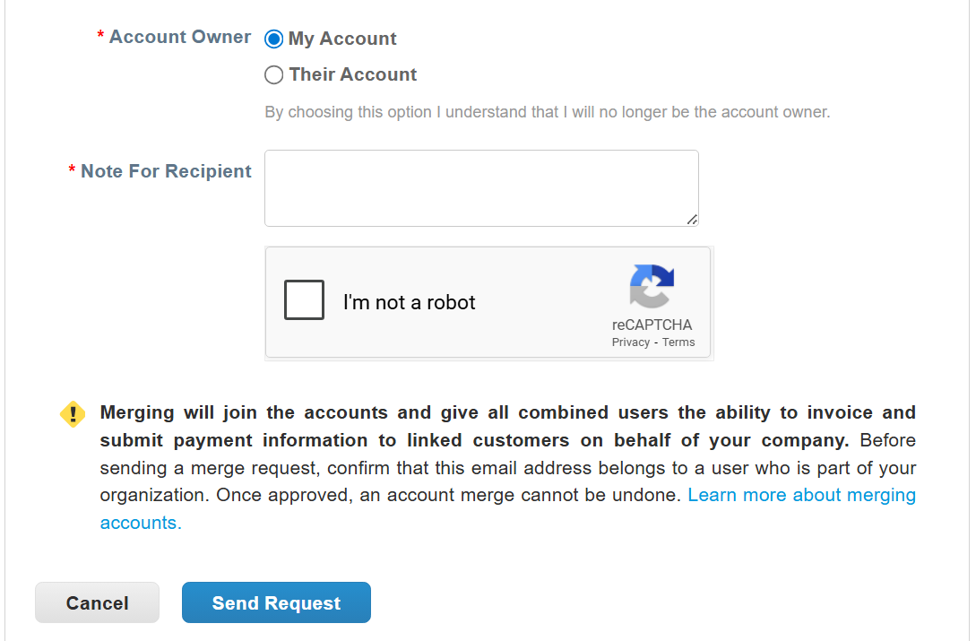
EXAMPLE
How to Merge Accounts (2/4)
5
How to Merge Accounts (2/4)
Select which account you wish to be the account owner using the “Account Owner” radio buttons and add a “Note For the Recipient” if required* and click on the “I’m not a robot” check box
Click on the “Send Request” button to send the Merge request
6
*Note: you will still be able to log into the account with both login details.

Slide 8
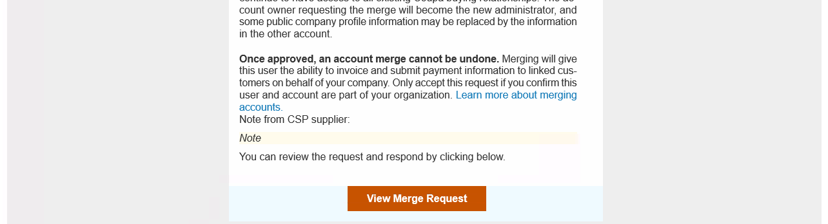
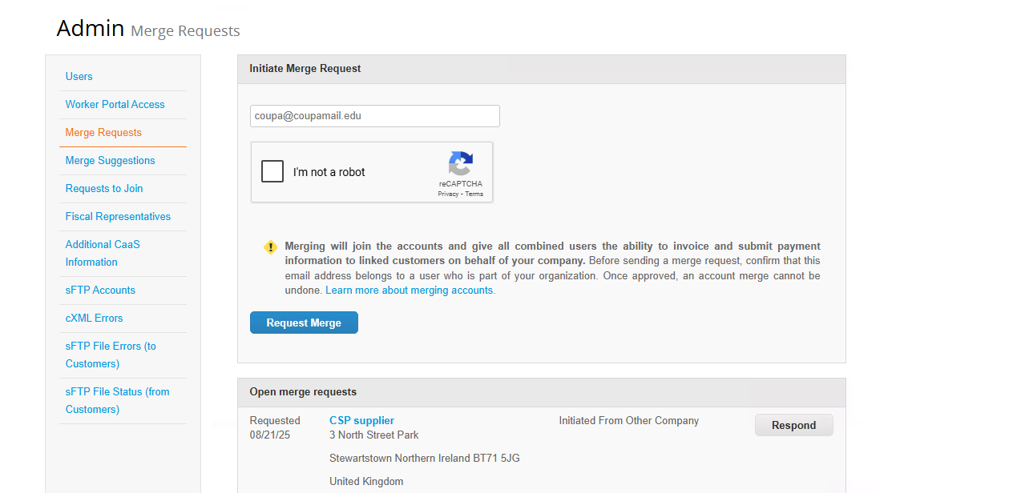
EXAMPLE
How to Merge Accounts (3/4)
How to Merge Accounts (3/4)
The email address you inputted during the merge request process will receive an email notification; they will need to press the “View Merge Request” button
The recipient will then be taken to the CSP and will see an Open merge request under the Merge Request section of their account, the must click on the “Respond Button” to accept the merge request
7
8

Slide 9
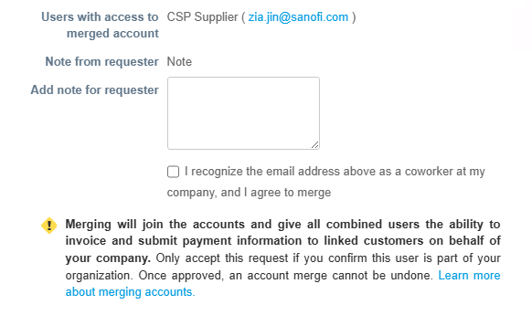
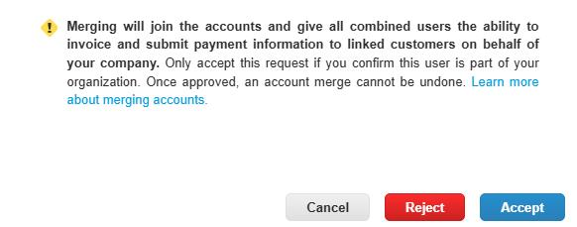
EXAMPLE
How to Merge Accounts (4/4)
How to Merge Accounts (4/4)
The recipient will need to check the “I recognise the email address above as a coworker at my company, and agree to merge” check box*
Once, this check box has been ticked they will then be able to accept the request by clicking on the “Accept” button – now both users will have the ability to invoice and submit payment information to linked customers on behalf of Sanofi
9
*Note: The user will not be able to accept the request until this check box has been ticked.
10

Slide 10
15
How to Manage Notifications

Slide 11
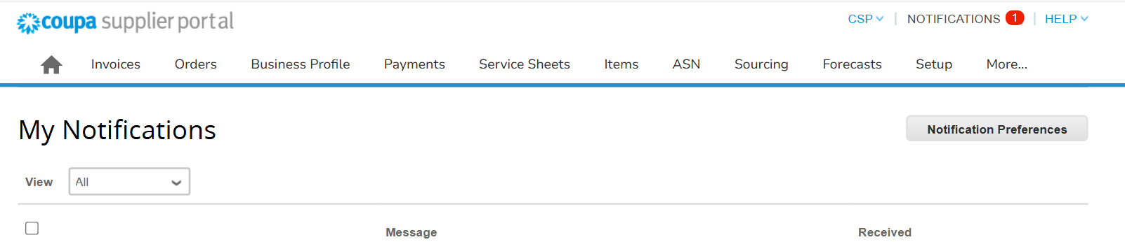
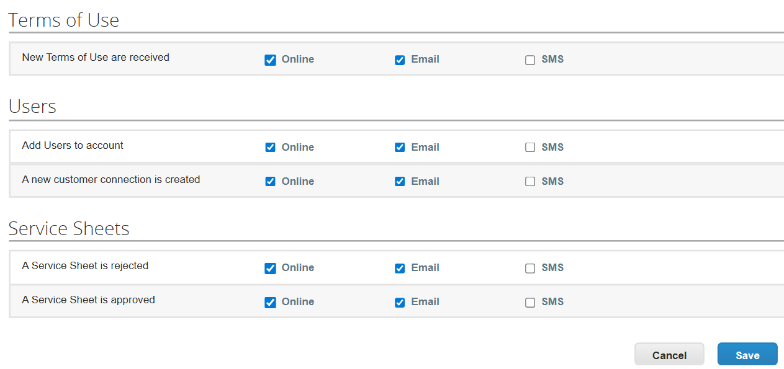
How to Manage Notifications
1
Managing Notifications
To manage CSP notifications, on the CSP homepage:
Click on “NOTIFICATIONS” at the top of your screen
Click on the “Notification Preferences” button
On the “Notification Preferences” page, you can enable/disable “Online”, “Email”, and “SMS” notifications as required
Once complete, click the “Save” button at the bottom of the page to confirm your notification settings
2
3
4

Slide 12
16
How to Add Comments to Invoices and Credit Notes

Slide 13
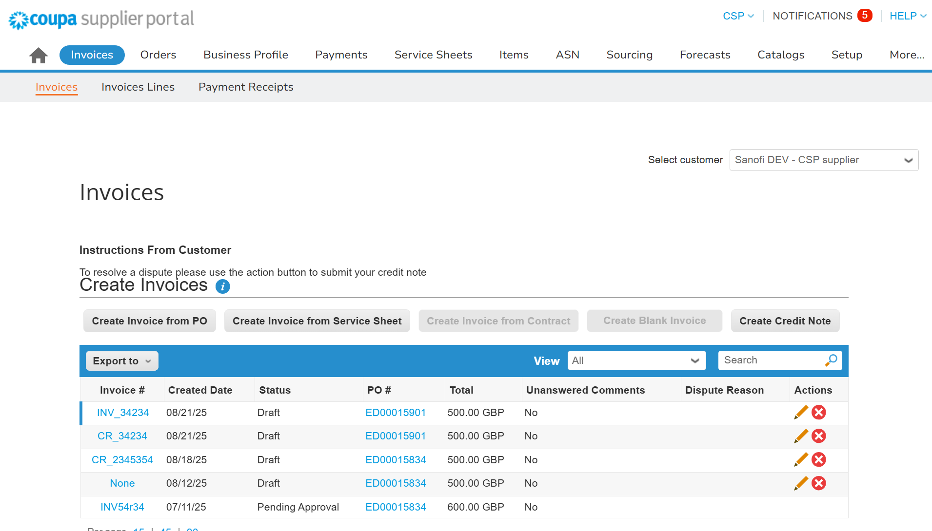
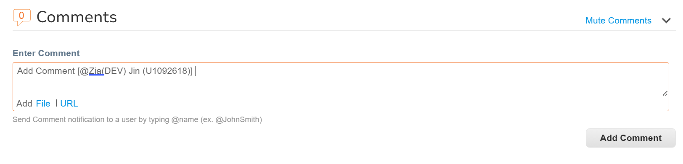
How to Add Comments to Invoices and Credit Notes
1
How to Add Comments to Invoices and Credit Notes
To add a comment to an Invoice or Credit Note:
Navigate to the “Invoices” tab, here you can view all invoices and credit notes
Ensure to select Sanofi in the “Select Customer” drop-down
Use the search bar to search for the Invoice or Credit Note you wish to add a comment to
Select the Invoice or Credit Note # Link under the Invoice # column to open the Invoice or Credit Note
Scroll to the bottom of the page and enter a comment in the Enter Comment box and click the “Add Comment” button to submit the comment, You can use the @ functionality to send a notification to a specific Sanofi user*
2
4
3
5
*Note: You cannot delete a comment once submitted, you are only able to edit the comment using the pencil icon.

